Slide 1

Prof. Srinivasa Chakravarthy V
Dept: Biotechnology
IIT-Madras
schakra@iit.ac.in

Slide 2
5.0 Limit Cycles:
Limit cycles are a type of oscillatory behavior characterized by two properties:
Periodicity:
A system exhibiting limit cycle behavior is confined to a closed loop trajectory and periodically visits every point on that loop. Thus, if a system whose state variable is denoted by x(t), visits a point, a, at time, t, and if ‘a’ is on a limit cycle, then
x(t) = x(t+T)=a,
where T is the period of the limit cycle.

Slide 3
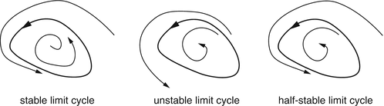
Limit Cycles

Slide 4
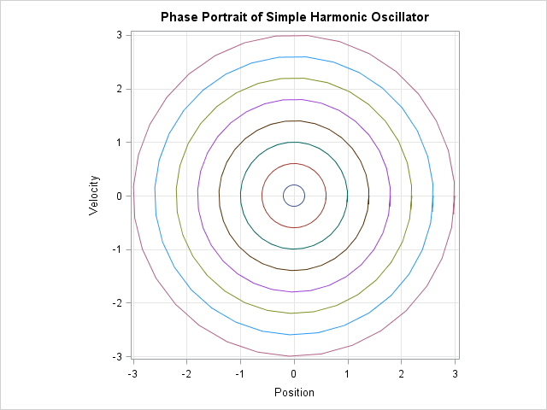
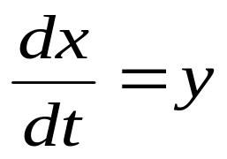
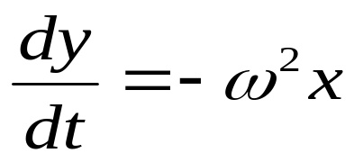
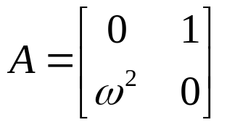

Simple Harmonic Oscillator
d²x/dt² + ω² x =0

Slide 5
Center vs Limit Cycle
Limit Cycle is periodic, and has a fixed
Amplitude irrespective of the initial condition
Center is periodic, but the amplitude depends on the initial condition

Slide 6
Isolatedness
This property refers to the behavior of the system when it is slightly perturbed from the limit cycle.
When a system begins at a point that is in the neighborhood of a limit cycle, it either approaches the limit cycle asymptotically, or moves away from it.
“Fixed amplitude”

Slide 7
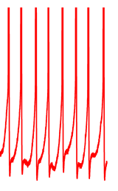
Neural Dynamics and Limit Cycles
Limit cycles are relevant to neural dynamics because neural spiking activity may be conveniently modeled as a limit cycle.
V(t) is periodic and has a fixed
Amplitude irrespective of the
Initial condition
V(t)

Slide 8
There are several ways in which it can be proved that a system exhibits limit cycle behavior, some of which are discussed below.
1. Special systems
2. Lienard Systems
3. Poincare-Benedixon Theorem

Slide 9
Special systems:
There is no general rule for determining if a system has limit cycle behavior.
This absence of general, universal methods is characteristic of nonlinear systems.
But some systems have a convenient form so that it can be easily shown that they have limit cycle behavior.

Slide 10
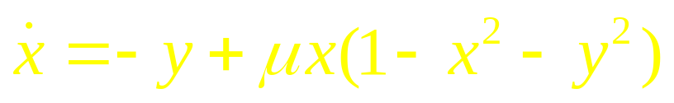
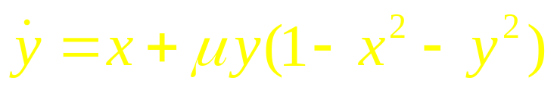
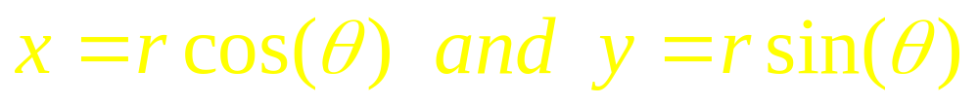
Example
Example: We can easily show the system given below has limit cycles –
(5.1a)
(5.1b)
Let us rewrite the above equations in polar form by substituting:

Slide 11
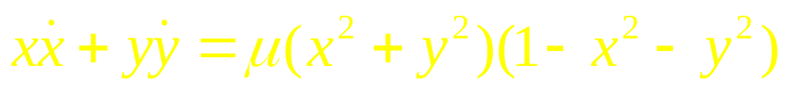
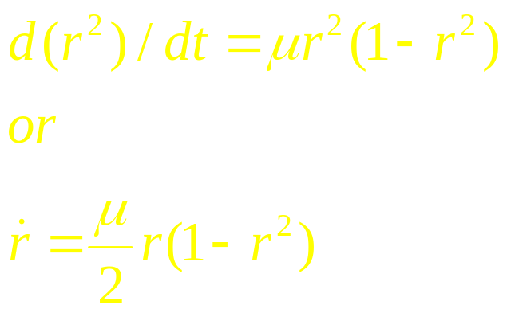
Combining eqns. (5.1a,b) as shown below
and expressing the result in polar coordinates we have
(5.2)

Slide 12
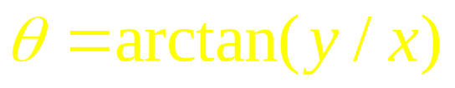
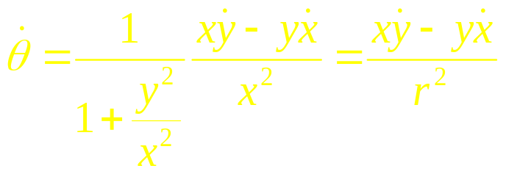
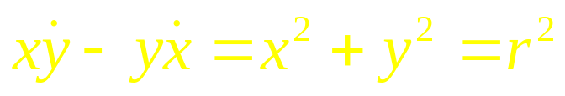

Now consider,
Differentiating both sides,
Using eqns. (5.1a,b) we have,
Combining eqn. (5.3) and eqn. (5.4) we have,
Thus eqns. (5.1a,b) are reexpressed as, eqns. (5.2) and eqn. (5.5).
(5.3)
(5.4)
(5.5)

Slide 13
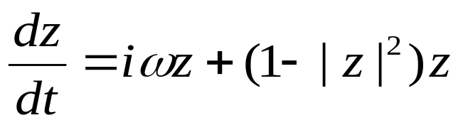
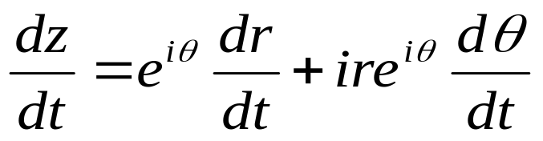

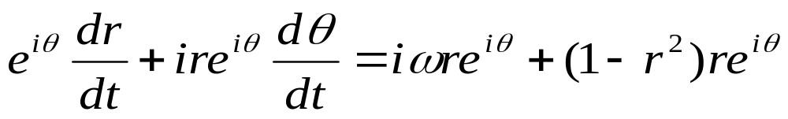
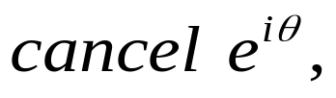
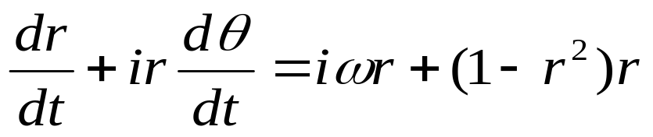
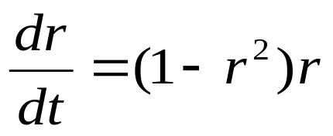
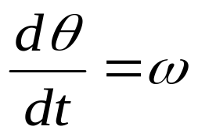
In Complex variable form
Let
Equating real and
imaginary parts:

Slide 14
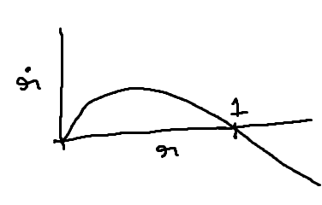
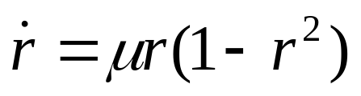
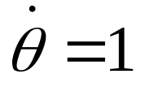
Dynamics in polar form
r approaches the stable of value 1: dr/dt is positive for r < 1, and is negative for r >1.
Thus we have a limit cycle which is a circle of unit radius and angular velocity of

Slide 15
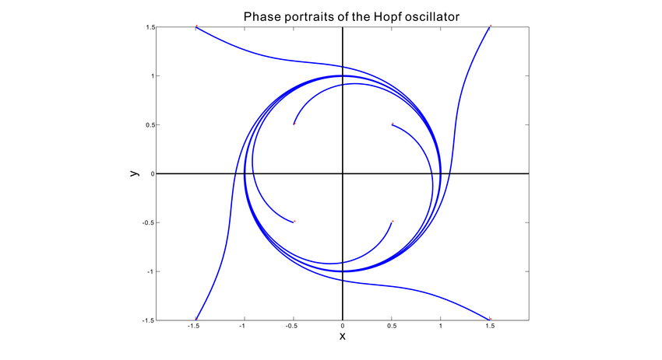

Slide 16
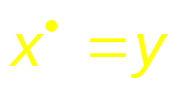
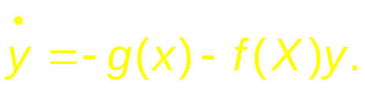
2.Lienard systems
This represents a slight improvement over showing limit cycles only in individual systems.
Lienard systems are a general class of systems that exhibit limit cycles under some conditions.
Liénard’s equation is equivalent to the system

Slide 17
The following theorem states that this system has a unique, stable limit cycle under appropriate hypotheses on and g. For a proof, see Jordan and Smith (1987), Grimshaw (1990), or Perko (1991).

Slide 18
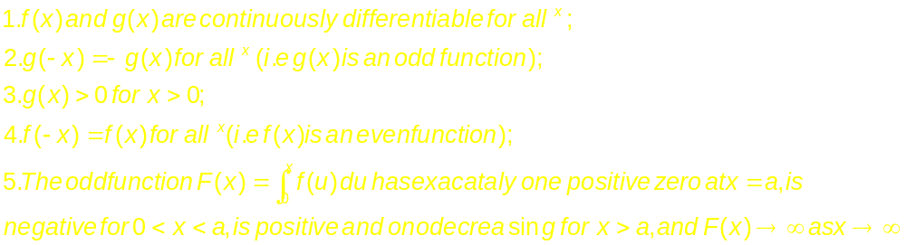
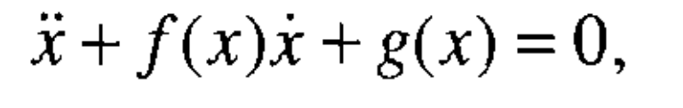
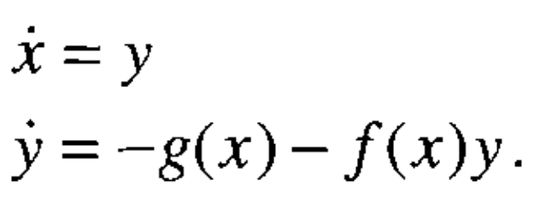
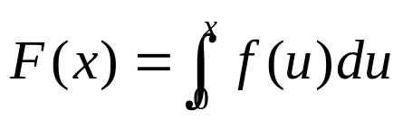

Lienard’s Theorem

Slide 19
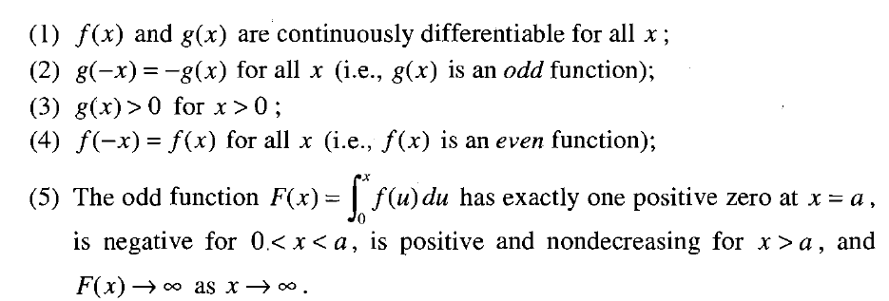
Lienard’s Theorem
Suppose that f (x) and g(x) satisfy the following conditions :
Then the system has a unique, stable limit cycle surrounding the origin
(Strogatz – Section 7.4)

Slide 20
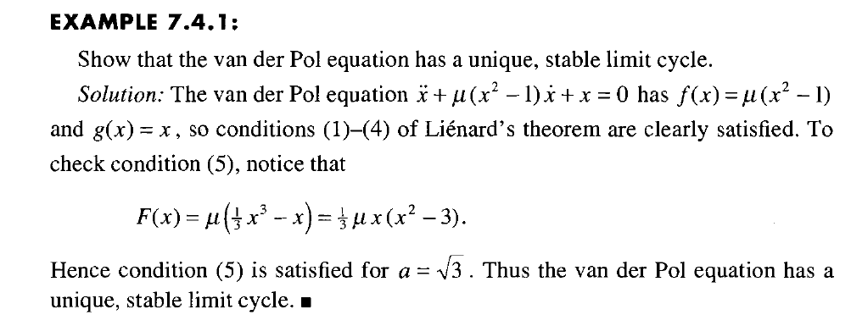
Example

Slide 21
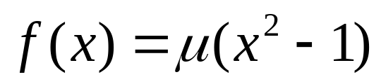
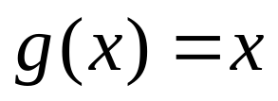
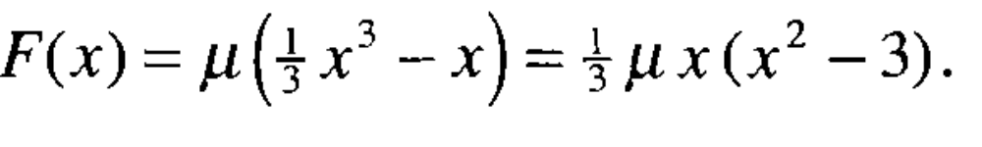
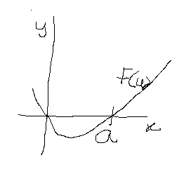
Even function
Odd function; g(x)>0 for x>0

Slide 22
3. Poincare-Benedixson Theorem:
This theorem specifies conditions in 2D systems under which limit cycle exists. It is based on the idea that in a dynamic system dx/dt = f(x), where f(x) is continuous, no two trajectories intersect. Therefore, if there is a limit cycle, then all trajectories that start from inside the limit cycle will remain confined within the limit cycle. They can never come out of the limit cycle since to come out they have to cross the limit cycle, which is disallowed.

Slide 23
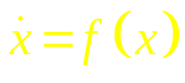
A formal statement of Poincare-Benedixson theorem is given below.
represents a continuously differentiable vector field on an open set containing a region R,
Where R is a closed, bounded subset of the plane, which is devoid of any fixed points, and
There exists a trajectory C that is “confined” in R (if it starts in R it stays in R forever).
If the above conditions are satisfied, C is a closed orbit.

Slide 24
It is not straightforward to apply Poincare-Benedixson theorem to a given system and show presence of limit cycles. Such demonstration depends crucially on construction of a trapping region, R, such that vector field on the borders of R points inwards everywhere.
T here is a theorem from Index theory that any closed orbit must enclose one or more fixed points. Since Poincare-Benedixson requires that R must not include any fixed points, we need to construct an R that excludes all fixed points. Typically a ring-like, annular region is chosen such that vector field is pointed inwards on the outer boundary, and outwards on the inner boundary. If such a region can be constructed, Poincare-Benedixson assures us that a limit cycle exists inside R. Exact construction of R depends on the details of the equations that describe the system.

Slide 25
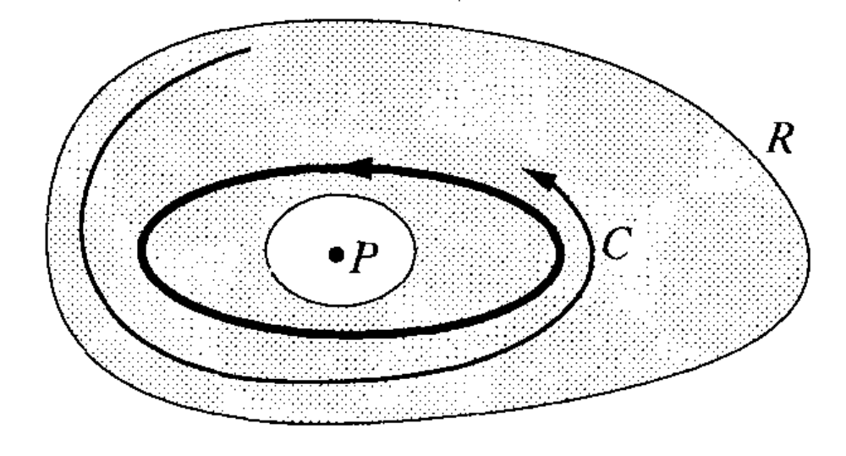
(Strogatz 1994)

Slide 26
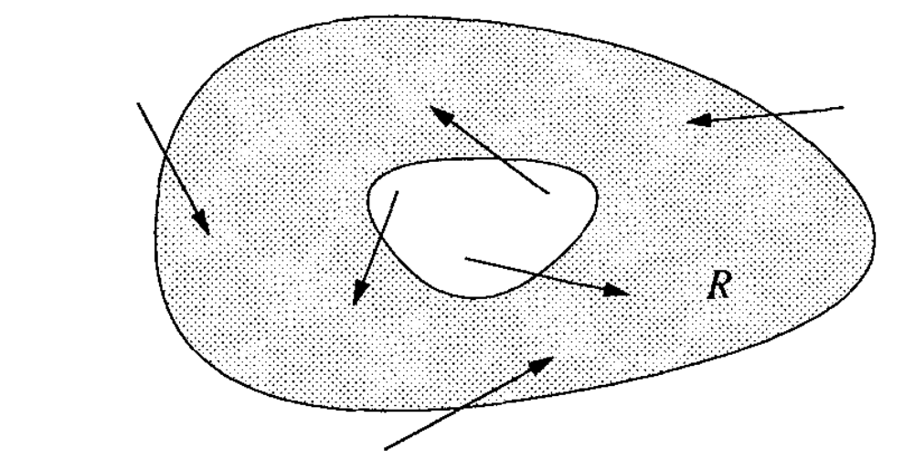

Slide 27
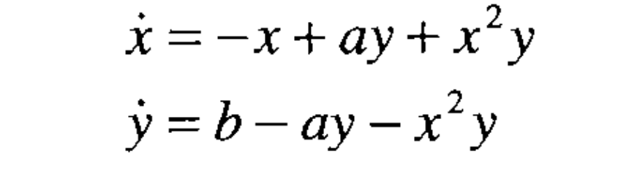
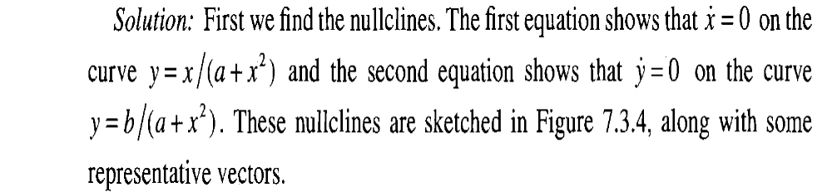
Example

Slide 28
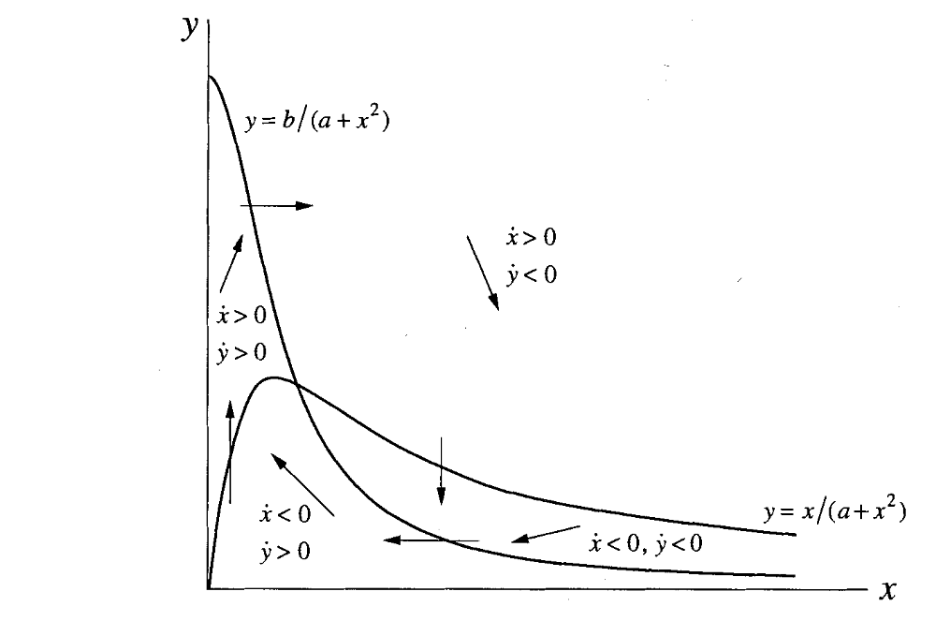

Slide 29
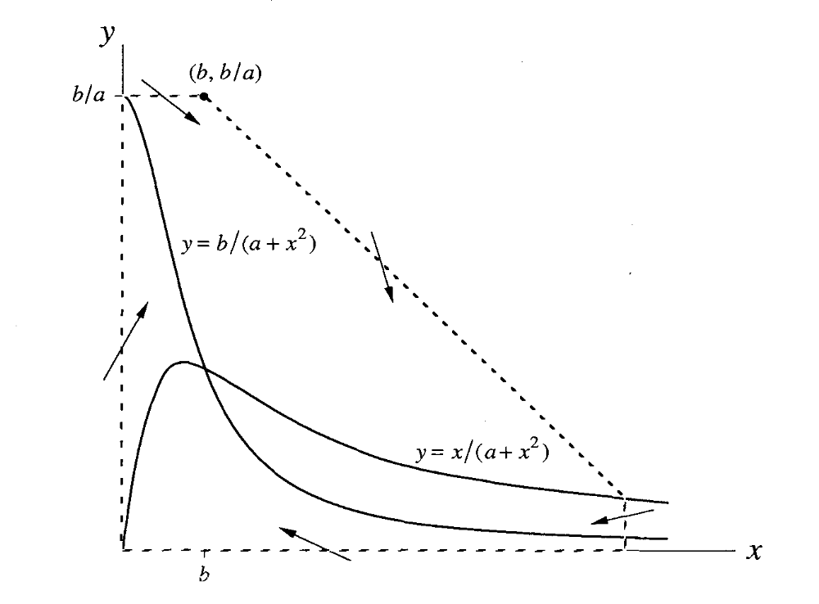

Slide 30
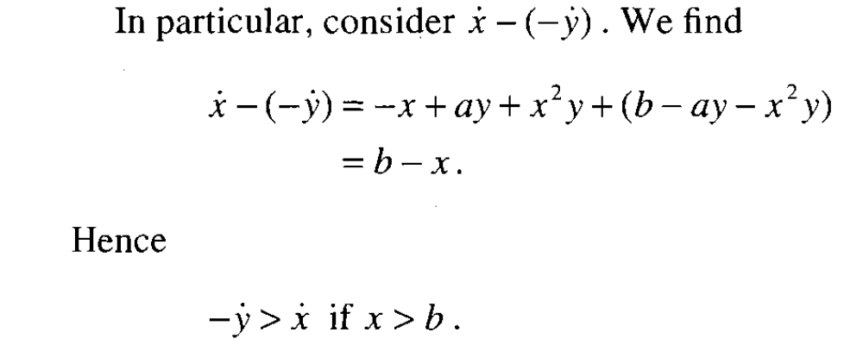

Slide 31
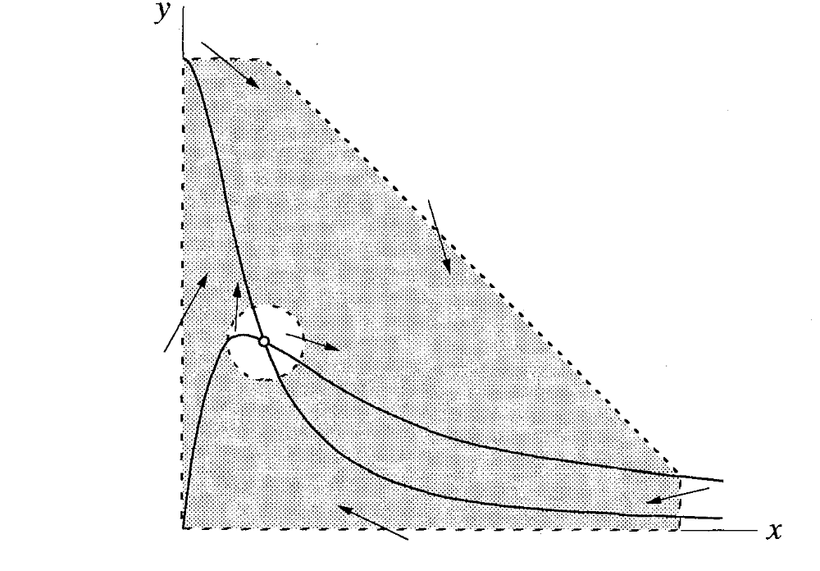

Slide 32
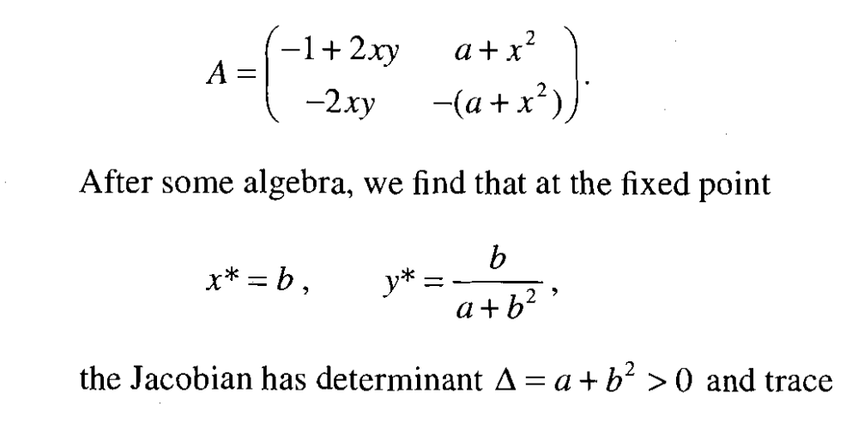

Slide 33
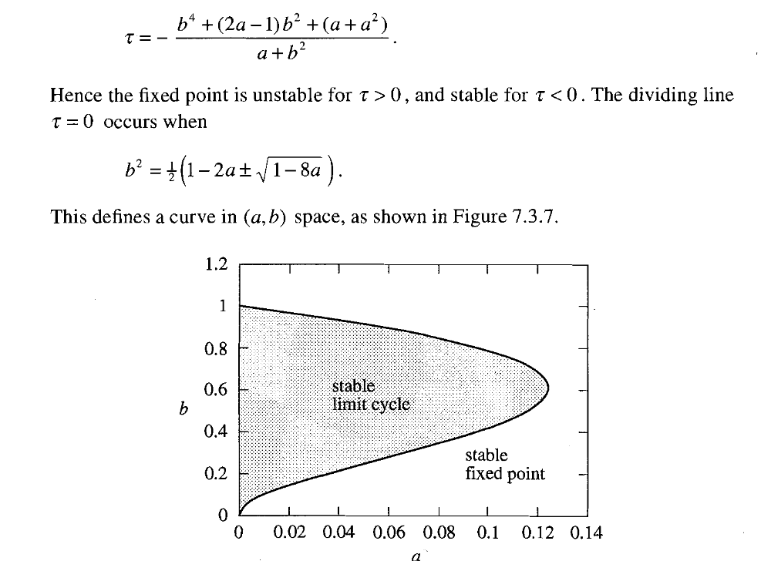

Slide 34
6.0 Limit Cycle generation by Bifurcation:
As the parameters of a dynamic system are changed gradually, at certain critical values of the parameters, the dynamics can change qualitatively. For example, a stable node may change into an unstable node. Such qualitative changes in dynamics are known as bifurcations. The parameter values where such changes occurs are called bifurcation points.
The map of fig. ** which shows different types of fixed points on the t- D plane is a simple example of bifurcations. The plane is divided into several regions, where each region represents one type of fixed point, or a dynamical regime. When we crossover from one region to a neighboring, dynamics suddenly changes, and a bifurcation occurs. For example, when we cross the D -axis (t = 0 line), saddle node become either stable or unstable nodes.

Slide 35
Two important types of bifurcations by which limit cycles can be produced are
Supercritical Andronov-Hopf bifurcation
Subcritical Andronov-Hopf bifurcation
Saddle-node bifurcation
Saddle-node on invariant circle bifurcation

Slide 36
6.1 Andronov-Hopf Bifurcation – supercritical and subcritical
In Andronov-Hopf bifurcation, a stable focus gets converted into an unstable focus giving rise to a limit cycle in the process. A stable focus, as we know from the previous section, has complex valued eigenvalues with negative real parts; the eigenvalues of the unstable focus has positive real parts. Thus Andronov-Hopf bifurcation occurs when a pair of complex conjugate eigenvalues cross over from the left halfplane to the right.
X’
X

Slide 37
Depending on the precise manner in which a stable focus gets destabilized and leads to a limit cycle, the Andronov-Hopf bifurcation can be classified into two types.
In supercritical Andronov-Hopf bifurcation, when a stable focus becomes a limit cycle, the limit cycle first starts with a small/infinitesimal amplitude and gradually increases in size.
This behavior can be seen in an example.

Slide 38
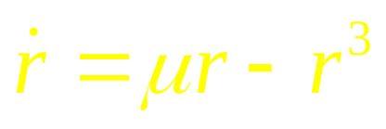
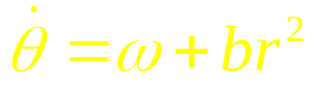
Example:
6.1.1a
Note that q does not influence evolution of r (in eqn. (6.1.1.a)) but r influences q (in eqn. (6.1.1.b)). Therefore changes in amplitude may be studied solely by studying eqn. (6.1.1.a).
Note how the steady state value of r changes as m is increased from a negative value to a positive value. For m <0, the only real solution is r = 0; for m >0, there are three real solutions: r = 0, + sqrt(m). Since r has to be positive, the solutions are r = 0 and sqrt(m). Eqn. (6.1.1.b) simply says that angular velocity increases with increasing radius.
6.1.1b

Slide 39

Therefore, if we express the steadystate radius, rs, as a function of bifurcation parameter, m ,
It can be easily verified that in the system defined by eqns. (6.1.1.a,b), the eigenvalues at the origin cross over from the left half-plane to the right, as m crosses over from negative to positive values.
for m>0, and

Slide 40




Eigen values analysis for eqns. (6.1.1.a,b)

Slide 41




Slide 42
Properties of supercritical Andronov-Hopf bifurcation
1. Size of the limit cycle,r_{0,} grows as for close to.
r₀
0

Slide 43




2. Frequency , evaluated at
Formula is exact at birth of the limit cycle.

Slide 44
Subcritical Andronov-Hopf bifurcation:-
In a subcritical Andronov-Hopf bifurcation, when the unstable focus destabilized, a limit cycle of finite size sudden appears, unlike in the supercritical case the limit cycle starts of small and grows gradually as the bifurcation parameter increases.

Slide 45



An example of a system which exhibits subcritical Andronov-Hopf bifurcation is given below:
Thus for m < 0, there is no limit cycle; there is a stable fixed point at the origin.

Slide 46


But when m >0, there is suddenly a limit cycle at r = r0, a finite value.

Slide 47

Thus, in supercritical Andronov-Hopf bifurcation, the size of limit cycle varies as a function of m as follows:

Slide 48
Saddle node bifurcation of cycles:
In saddle node bifurcation of cycles (also called a fold bifurcation), two limit cycles coalesce and annihilate each other. A simple example system that exhibits Saddle node bifurcation of cycles is,
Note the system is the same as the used in case of the subcritical Andronov-Hopf bifurcation above. But the difference lies in the value of bifurcation parameter at which the bifurcation occurs.

Slide 49

In case of subcritical Andronov-Hopf bifurcation, the bifurcation occurred at m = 0. For m < 0, there is a stable focus at the origin, an unstable limit cycle of lesser radius, and a stable limit cycle of larger radius. When m > 0, the unstable limit cycle merges with the origin and disappears. The stable limit cycle only remains.
In case of Saddle node bifurcation of cycles, the bifurcation occurs at m = -1/4.
For m < -1/4, origin is the only stable point. There are no limit cycles (stable or unstable).

Slide 50

For m > -1/4, origin is still a stable point. But in addition there are now two limit cycles (one stable and the other unstable).
Therefore a key difference between subcritical Andronov-Hopf bifurcation and Saddle node bifurcation of cycles is the former, the stable focus at the origin becomes unstable after bifurcation, whereas in the latter the focus at the origin remains stable throughout.

Slide 51

Saddle node on invariant Circle:
In this type of bifurcation, a node and saddle are located on a loop – the invariant circle. By varying a bifurcation parameter, the saddle and the node come together, coalesce and annihilate each other leaving the loop, the limit cycle, intact.
A sample system that displays Saddle node on invariant Circle behavior:

Slide 52


For m < 1, the phase dynamic equation has two solutions – saddle and a node located on the unit circle (r = 1). Phase portrait is shown in the figure below. As m → 1, the saddle and the node approach each other and coalesce. When m > 1, the saddle and the node annihilate each other leaving a limit cycle at r = 1.
m > 1
m < 1

Slide 53
Homoclinic Bifurcation:
In a homoclinic bifurcation, a closed loop approaches a saddle. At bifurcation, the saddle touches the loop, transforming the loop into a homoclinic orbit. Thus trajectories that start from the saddle go along the loop and return to the saddle in the opposite direction.

Slide 54


The limit cycle with the
saddle outside
b. The saddle had merged with the limit cycle.
The cycle has now become a homoclinic orbit.

Slide 55

Thank You

